Slide 1
Growing with Gaming
A Data Analysis of Steam Games

Slide 2

Steam Powered
For those who don’t know,
Steam is a video game platform that holds a wide amount of video games from the deep sea of many video game developers
They range from triple A title’s
To smaller teams of developers
Triple A simply means a corporate studio that is typically known just by their studio name and popular games they release.

Slide 3



Ever See this Logo?

Slide 4
Valve Corporation
It’s a funny looking logo that shows up in their games although they have a couple of games themselves it’s not even close to the amount of variety on steam
Valve is the corporation that created steam, the reason I’m sharing this is because there’s always content being added to the platform so it was a perfect idea for a data analysis!

Slide 5

The Good Stuff
The question(s) to be answered is “Has price of video games changed over time?”
“Does price affect positive ratings?”
And other questions answered and speculations from the data
WARNING: THIS NEXT SLIDE MIGHT BE TOO COOL FOR SOME PEOPLE TO HANDLE

Slide 6


Slide 7




OKAY WHERE’S THE DATA??
Wasn’t that cool? Action.
The next slides contain the graphed data, lets dive in

Slide 8
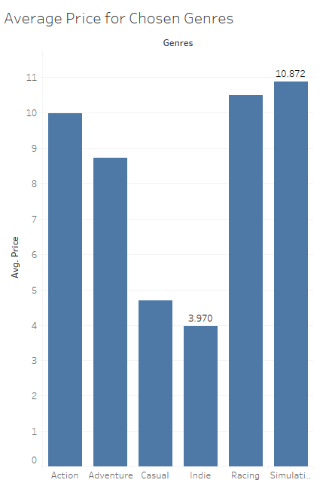
Average Prices from Chosen Genres

Slide 9
Big Three
I took the three genres with the highest average price and dived a little deeper. These three graphs are price changes over the years

Slide 10
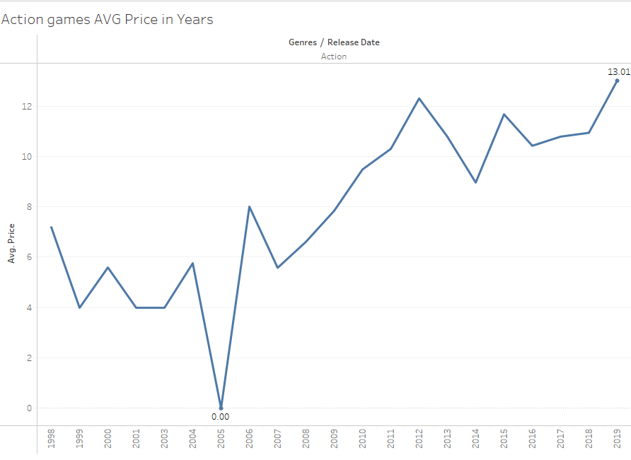

Slide 11
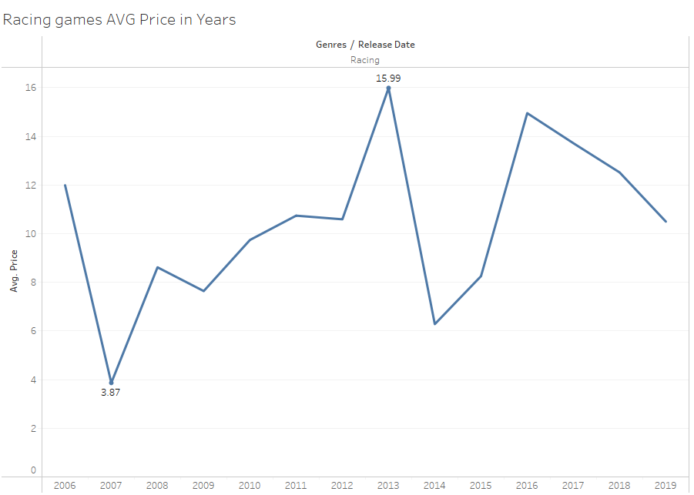

Slide 12
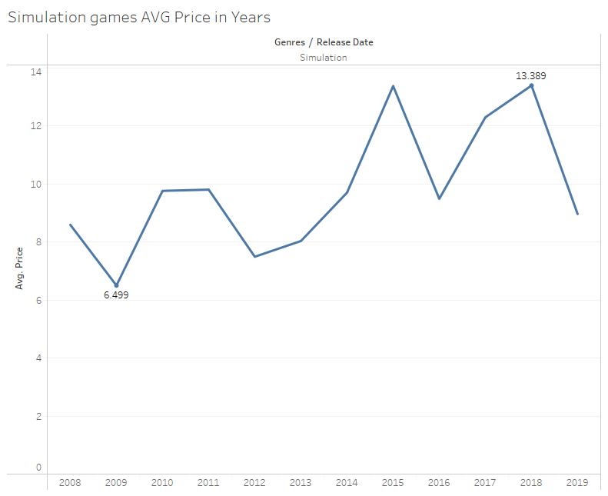

Slide 13
These Graphs are Changes over Months

Slide 14
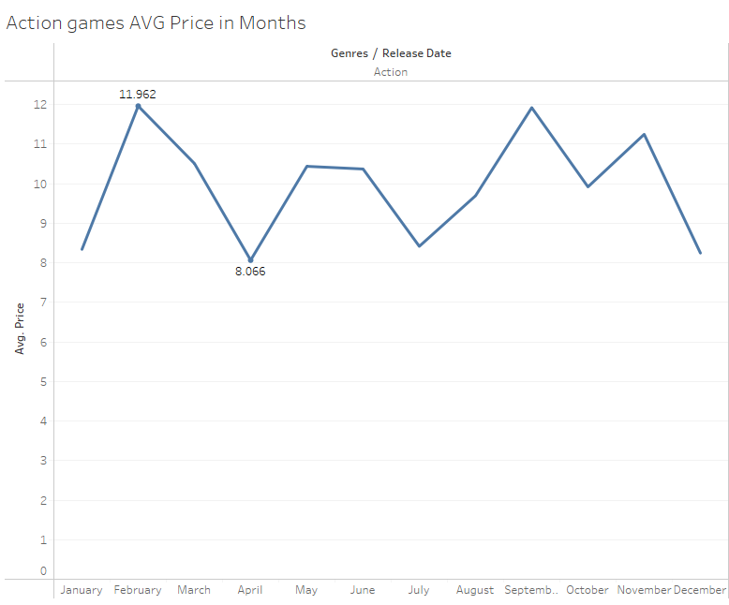

Slide 15
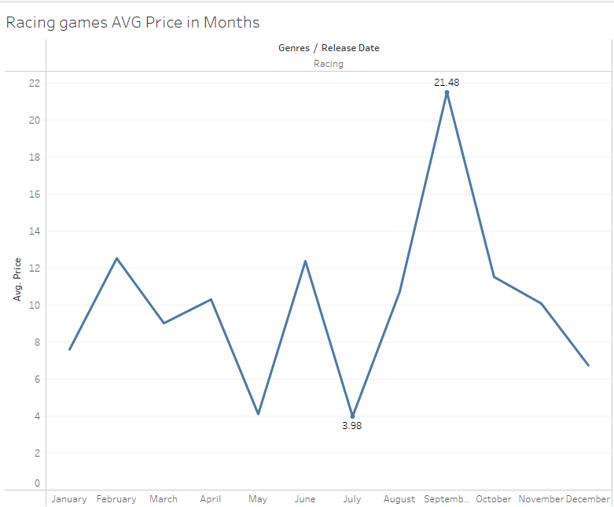

Slide 16
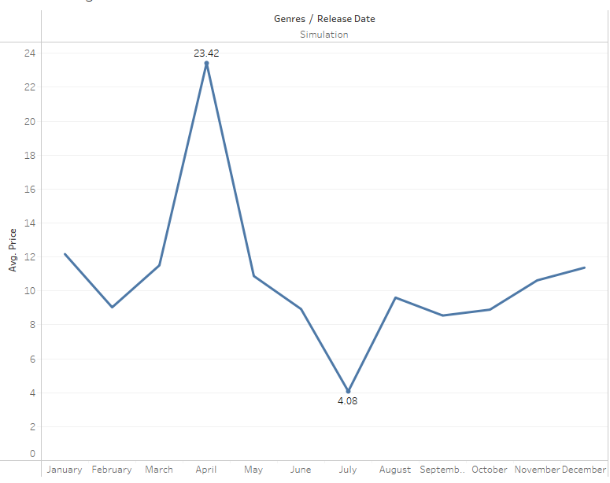

Slide 17
Last set of slides comparing price with positive ratings

Slide 18
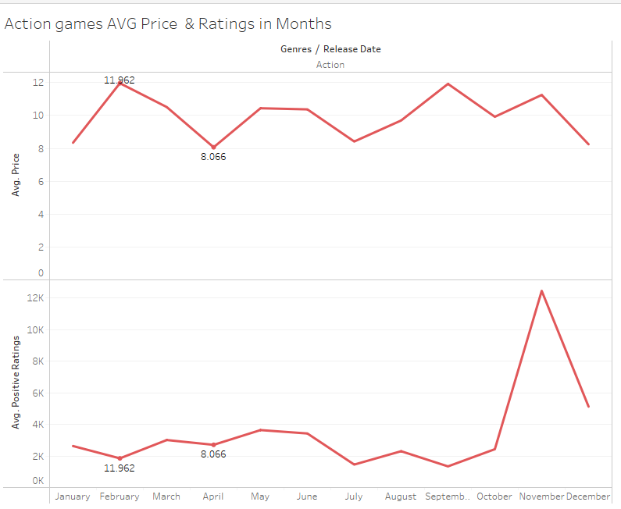

Slide 19
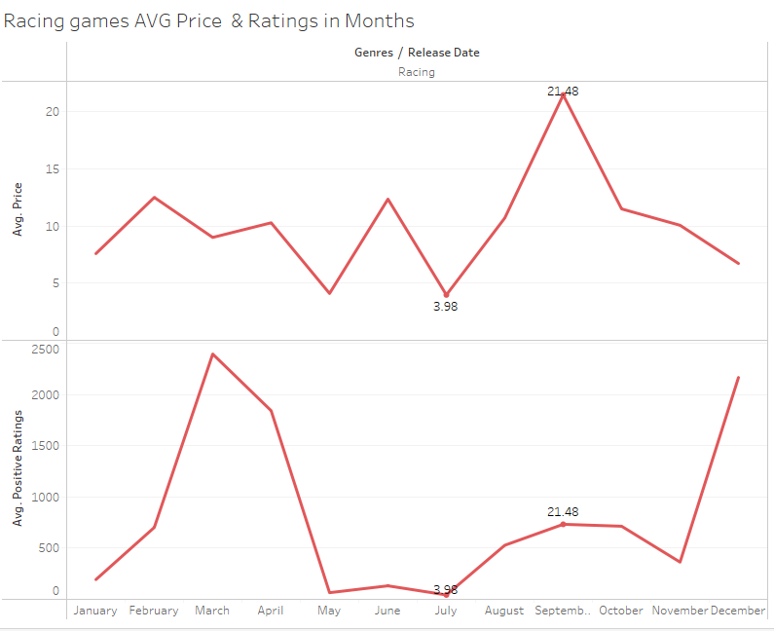

Slide 20
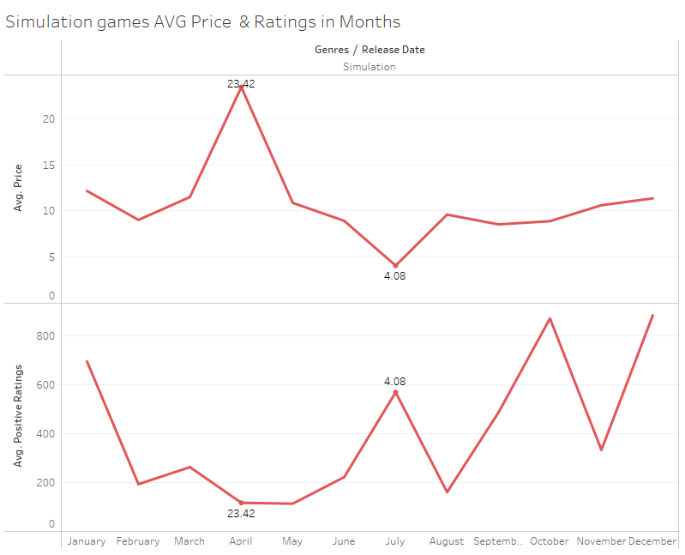

Slide 21
Concluding
The Action genre appears to be going up steadily with it’s average price yearly, this could be because it is the most popular. While Racing and Simulation appear to be heading on a downwards trend for yearly average price, people might not be buying as much
Although on a month-to-month basis, these genres only dip in the steam sales, but Simulation and Racing stay at a consistent higher price
We saw from the last graphs that it seems positive reviews seem to be higher when the price is lower, which honestly surprised me, I guess when people buy a game for a bargain it softens them up to review the game better

Slide 22


